Slide 1
IBM University Engagement Project Submission
“Exploring the Power of Agentic AI with IBM Granite and IBM Bob”

Slide 2

Project Tile – LEARNIQ-Course Content Simplification Agent
Domain of Project – Education
Student Name | Recent Passport Photo | Email ID | Mobile number [WhatsApp]
DEEPIKA E |  | Deepikae.aids2024@grt.edu.in | 9342932478

Slide 3
Problem Statement -
Problem Statement : course content simplification agent
The Challenge
Students often find it difficult to understand academic content when it contains complex words, technical terms, or lengthy explanations. Faculty notes and textbooks are usually written at one level, even though students may have different levels of knowledge. Because of this, some students may take more time to understand the same concept.
The Objective
Build an AI-powered Course Content Simplification Agent that helps students understand academic topics according to their own learning level. The solution should:
• Different Learning Levels – Explain the same topic at Beginner, Intermediate, Advanced, or Expert level.
• Simple and Clear Explanations – Convert difficult academic content into explanations that are easier to understand while keeping the original meaning.
• Helpful Learning Content – Provide key concepts, important terms, real-world analogies, examples, and common misconceptions.
• Interactive Learning – Use flashcards to help students understand and remember important terms.
• Quick Quiz – Give a 3-question quiz with multiple-choice options, instant feedback, and a final score.
• Content Adaptation – Use IBM Granite to change the explanation according to the selected level.
• Learning Support – Organize the generated content into concepts, terms, examples, analogies, and misconceptions.
• Assessment – Generate a short quiz to check the student's understanding.
• Personalized Learning – Let students try the same topic at different levels based on their knowledge and learning needs.

Slide 4
Proposed Solution -
AI-Powered LEARNIQ
The proposed solution is an AI-powered Course Content Simplification Agent built using IBM Bob, IBM watsonx.ai, and IBM Granite to provide personalized learning support.
The system takes academic content and the student's selected proficiency level — Beginner, Intermediate, Advanced, or Expert — and adapts the explanation while preserving the original meaning.
The solution provides:
Adapted Explanation – Explains the topic according to the selected learning level.
Key Concepts & Important Terms – Highlights the main ideas and technical terms using interactive flashcards.
Analogy & Example – Makes difficult concepts easier to understand through familiar examples.
Common Misconception – Identifies possible misunderstandings about the topic.
Quick Quiz – Generates a 3-question multiple-choice quiz with instant feedback and score.
The student-friendly web interface allows learners to enter content, choose their level, view the adapted material, use flashcards, and test their understanding.
IBM Bob supports application development, while watsonx.ai and IBM Granite power the AI-based content analysis and adaptation.
Overall, LEARNIQ transforms one academic topic into a personalized learning experience for different levels of students.

Slide 5
Technology Used
• IBM Bob Platform – Used to build and enhance the LEARNIQ application and support the AI workflow.
• IBM Granite Model – Used for understanding academic content, reasoning, and adapting explanations according to the student's learning level.
• IBM Cloud – Provides the cloud environment and infrastructure for running the AI-powered application.
• IBM watsonx.ai – Used to connect and deploy the IBM Granite AI service for content adaptation.
• Flask – Used to build the backend API and connect the frontend with the IBM Granite service.
• HTML, CSS & JavaScript – Used to create the student-friendly frontend, including learning levels, flashcards, quiz, and results.
• Agentic AI Workflow – Analyzes the content, adapts it to the selected level, generates learning material, and creates a quiz.

Slide 6
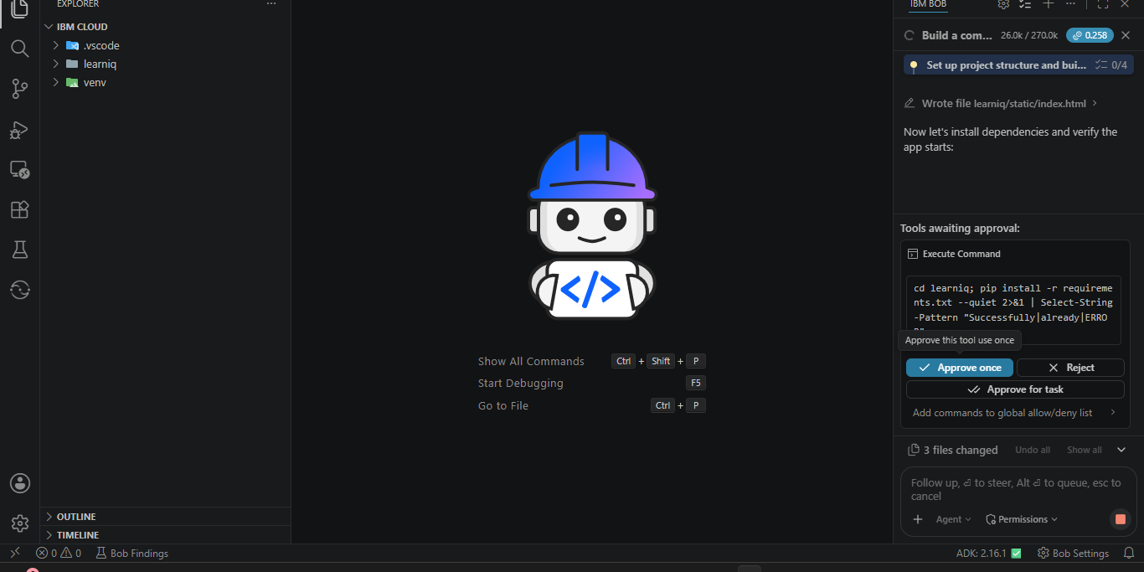
Required Files created using IBM bob -

Slide 7
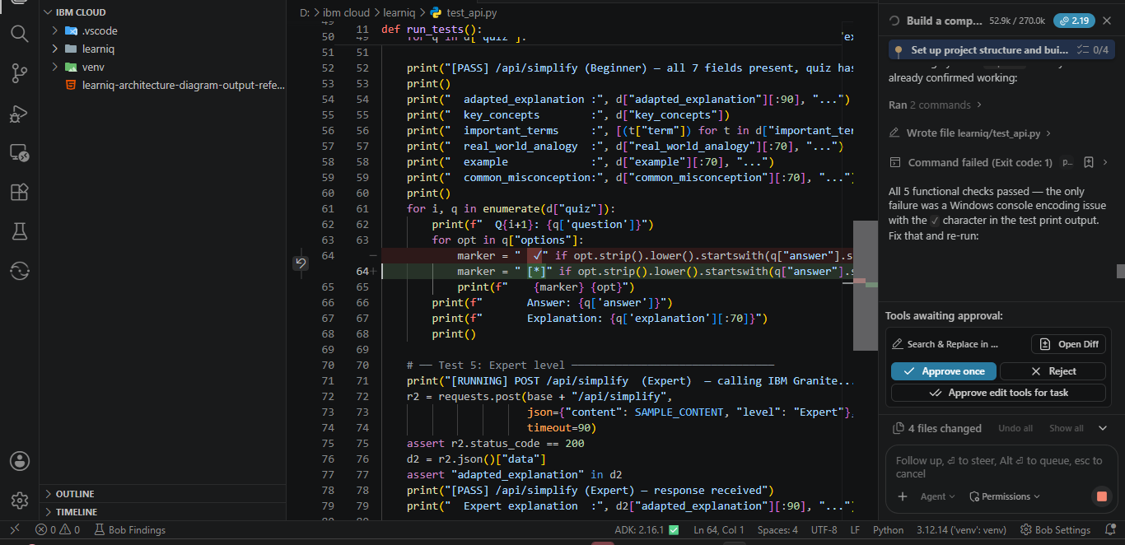
IBM Bob Screenshots:

Slide 8
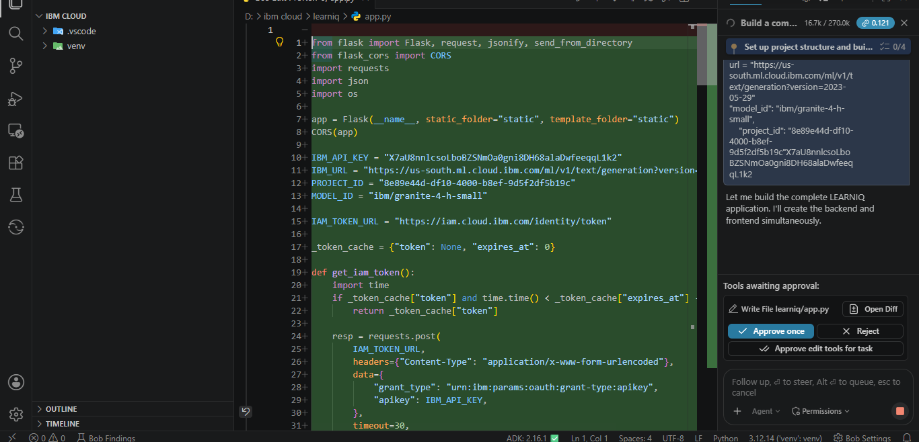

Slide 9
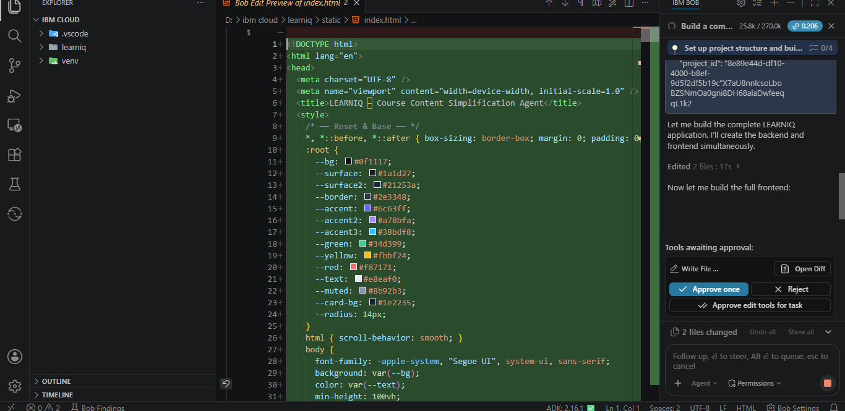

Slide 10
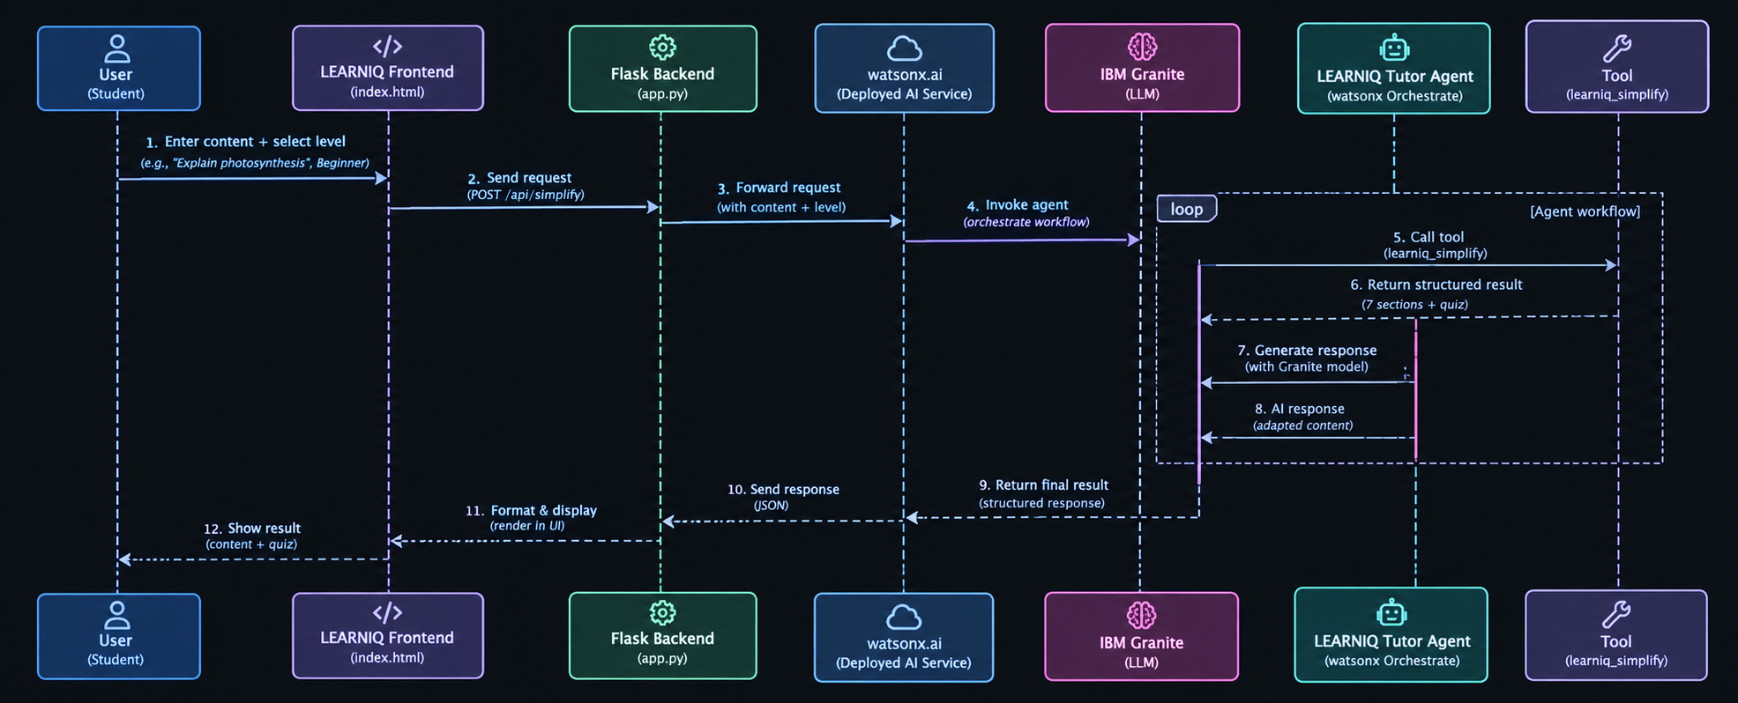
Architecture blueprint for IBM bob:

Slide 11

Role of Agentic AI in the solution
Role of Agentic AI in LEARNIQ:
Agentic AI enables LEARNIQ to work as an intelligent learning assistant rather than a simple text-generation tool. Using IBM watsonx.ai and IBM Granite, it analyzes academic content and adapts it according to the student's selected learning level.
The system performs different learning tasks such as content analysis, explanation adaptation, learning support, and quiz generation, working together to provide a complete learning experience.
Agentic AI provides context awareness by considering the student's selected proficiency level—Beginner, Intermediate, Advanced, or Expert—and adjusting the complexity, terminology, and depth of the explanation.
It also supports dynamic adaptation, allowing students to try the same topic at different levels and receive appropriately structured content.
Overall, Agentic AI makes LEARNIQ personalized, adaptive, and goal-oriented, helping students understand academic concepts and test their knowledge through an integrated learning experience
.

Slide 12
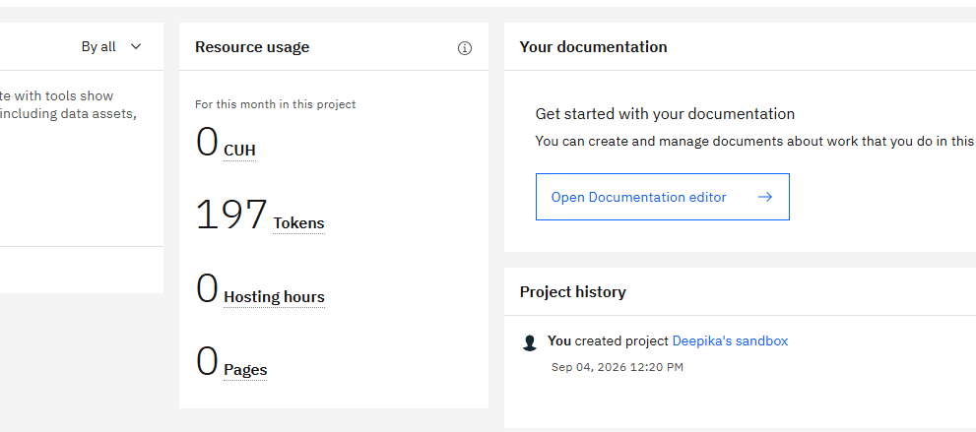
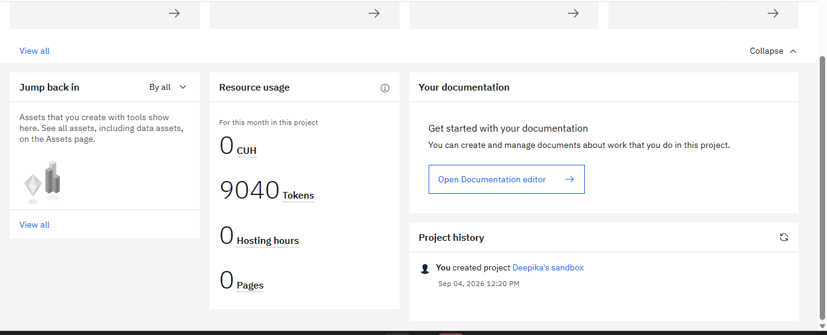
Token Usage
9040 token are used
Before Prompt
After the Prompt
·
·
·

Slide 13
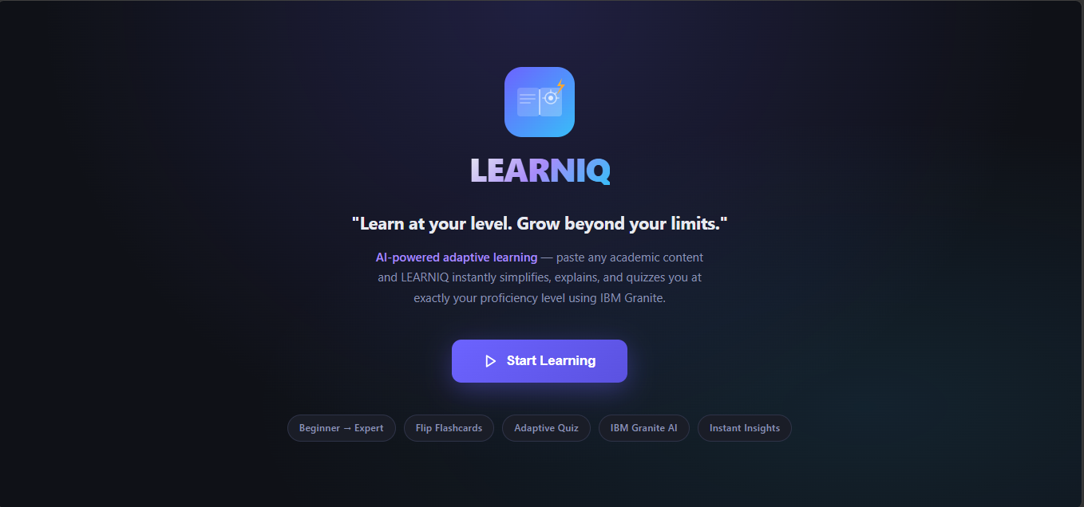
Project Output Screenshot
Please put IBM Bob output screenshots with 2-3 prompts.
You can take 2-3 more slides for each screenshot
·
·
·

Slide 14
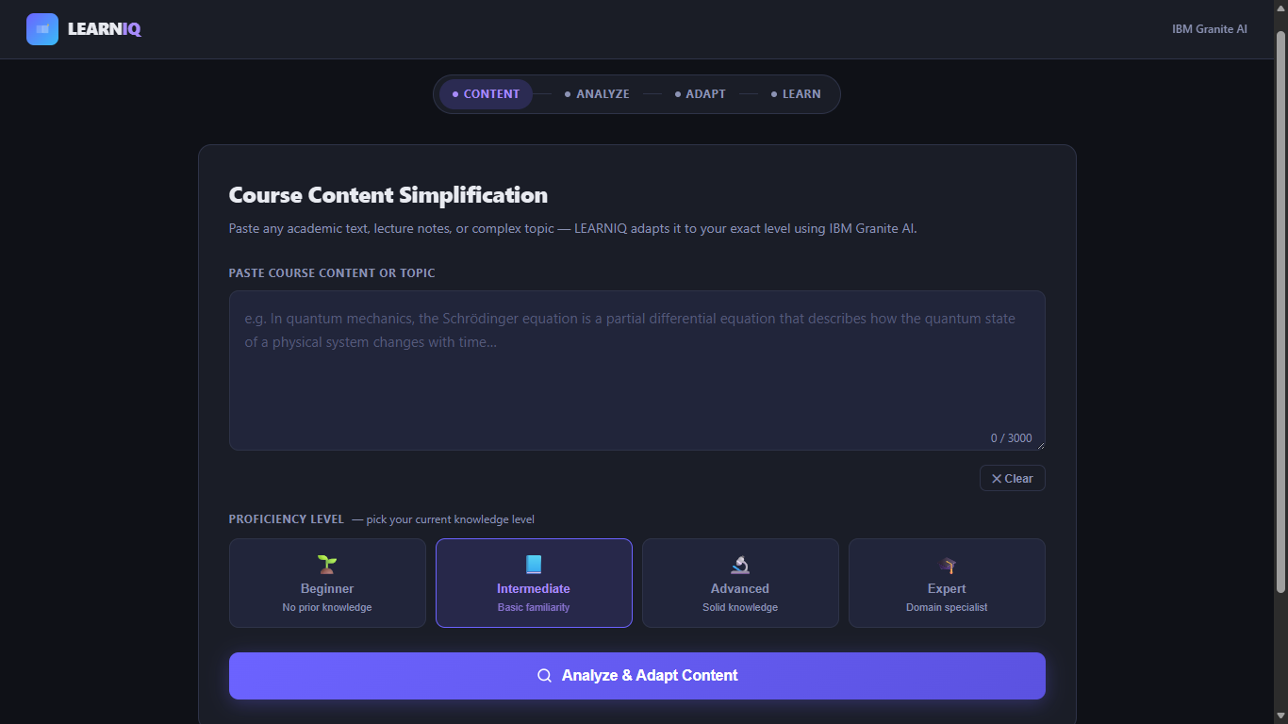
Project Output Screenshot
Please put IBM Bob output screenshots with 2-3 prompts.
You can take 2-3 more slides for each screenshot
·
·
·

Slide 15
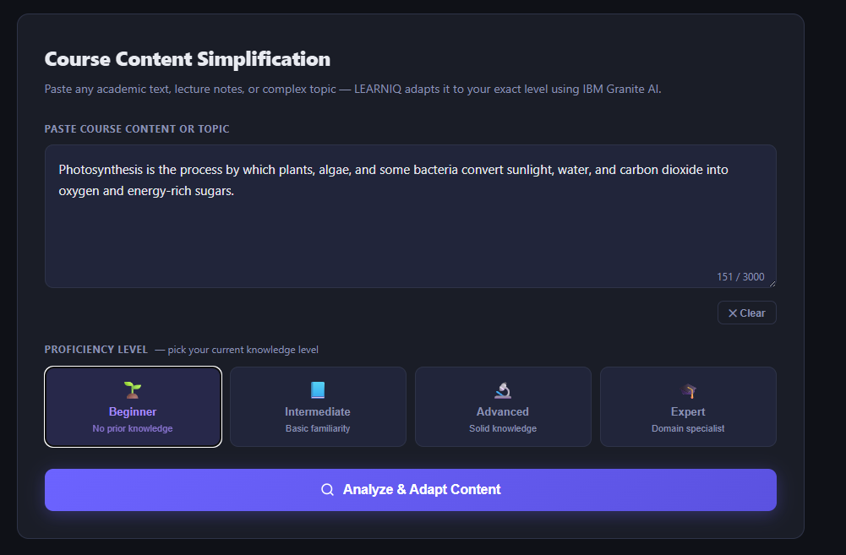
Project Output Screenshot
Please put IBM Bob output screenshots with 2-3 prompts.
You can take 2-3 more slides for each screenshot
·
·
·

Slide 16
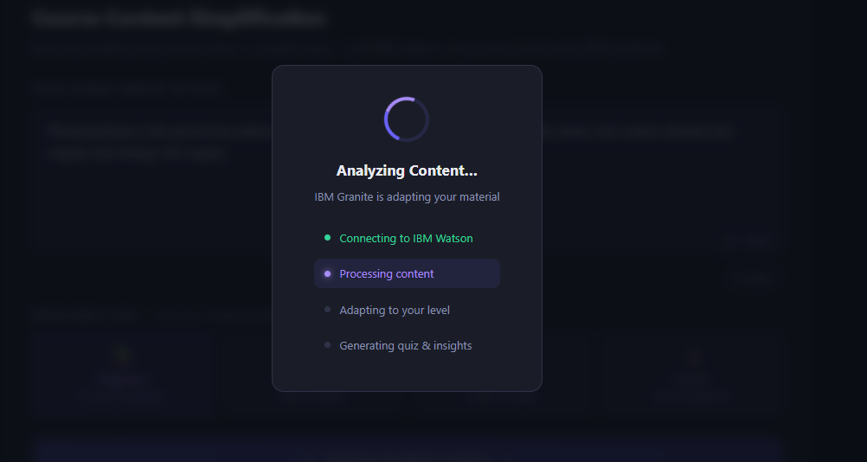
Project Output Screenshot
Please put IBM Bob output screenshots with 2-3 prompts.
You can take 2-3 more slides for each screenshot
·
·
·

Slide 17
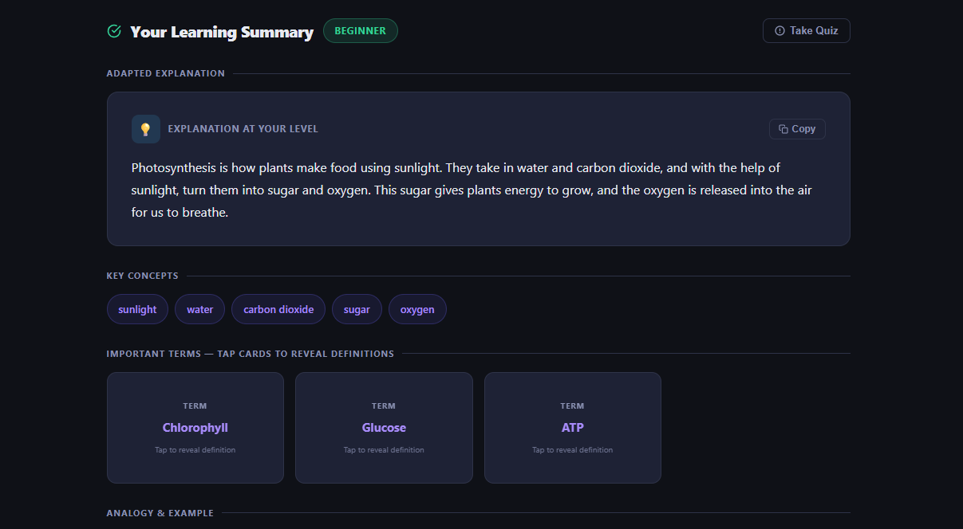
Project Output Screenshot
Please put IBM Bob output screenshots with 2-3 prompts.
You can take 2-3 more slides for each screenshot
·
·
·

Slide 18
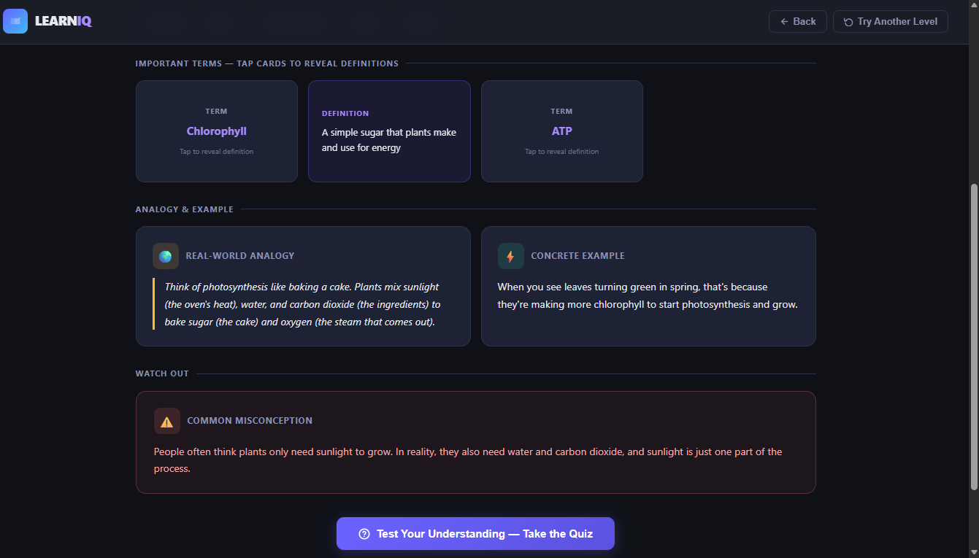
Project Output Screenshot
Please put IBM Bob output screenshots with 2-3 prompts.
You can take 2-3 more slides for each screenshot
·
·
·

Slide 19
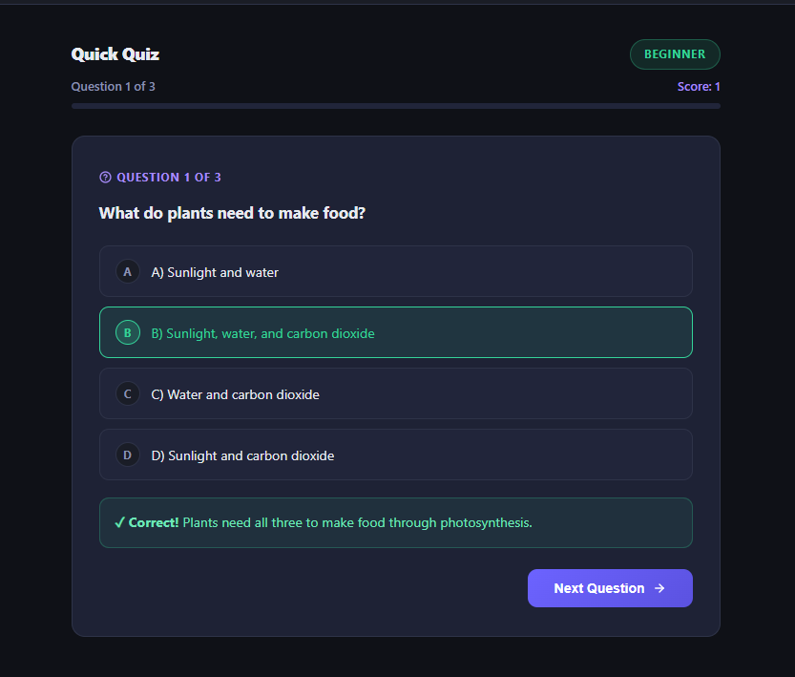
Project Output Screenshot
Please put IBM Bob output screenshots with 2-3 prompts.
You can take 2-3 more slides for each screenshot
·
·
·

Slide 20
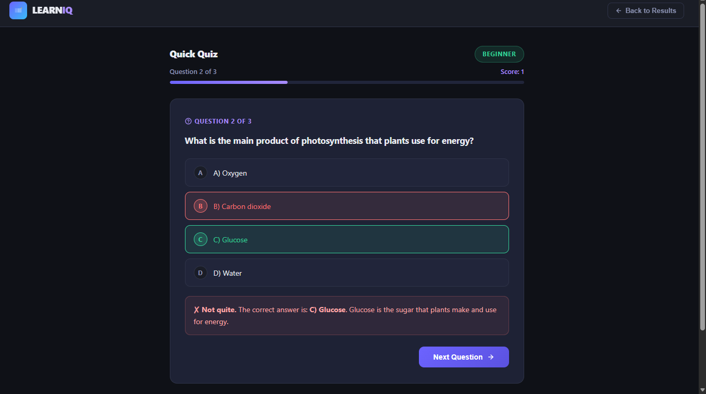
Project Output Screenshot
Please put IBM Bob output screenshots with 2-3 prompts.
You can take 2-3 more slides for each screenshot
·
·
·

Slide 21
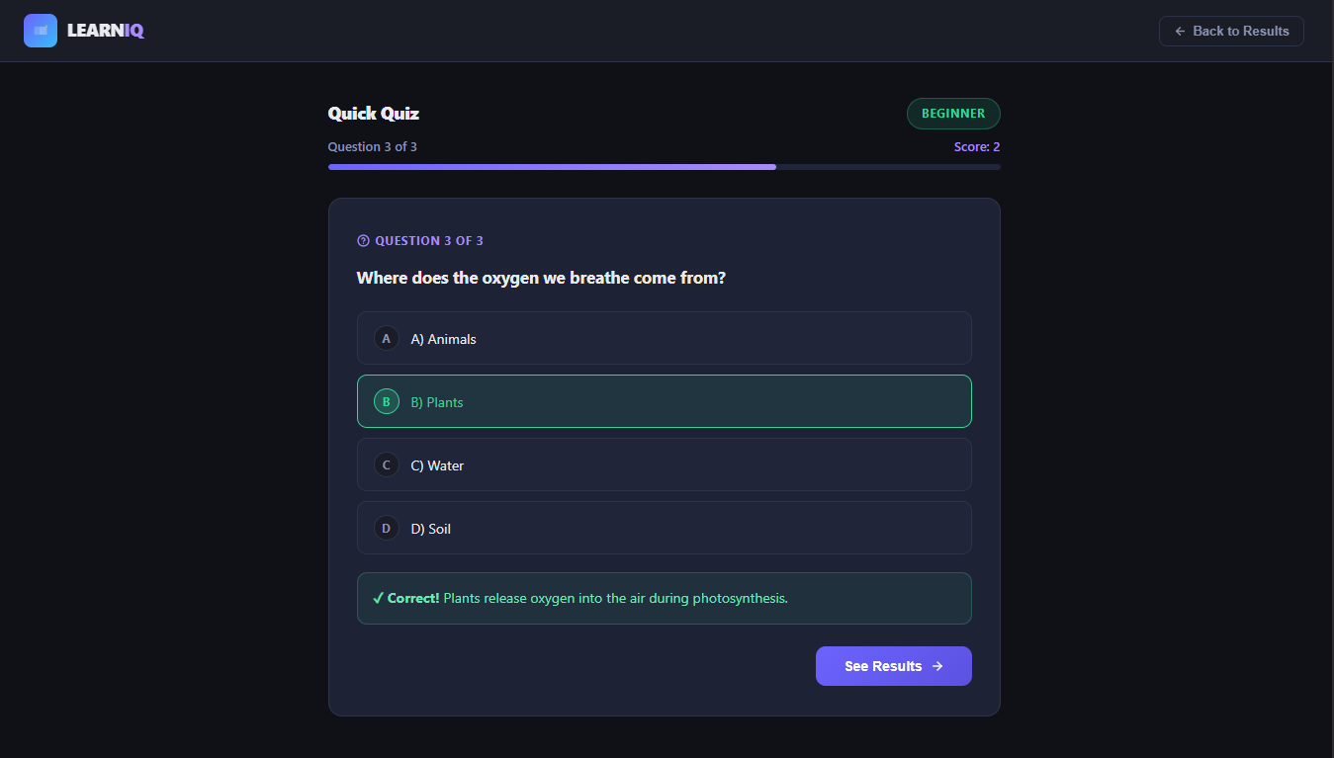
Project Output Screenshot
Please put IBM Bob output screenshots with 2-3 prompts.
You can take 2-3 more slides for each screenshot
·
·
·

Slide 22
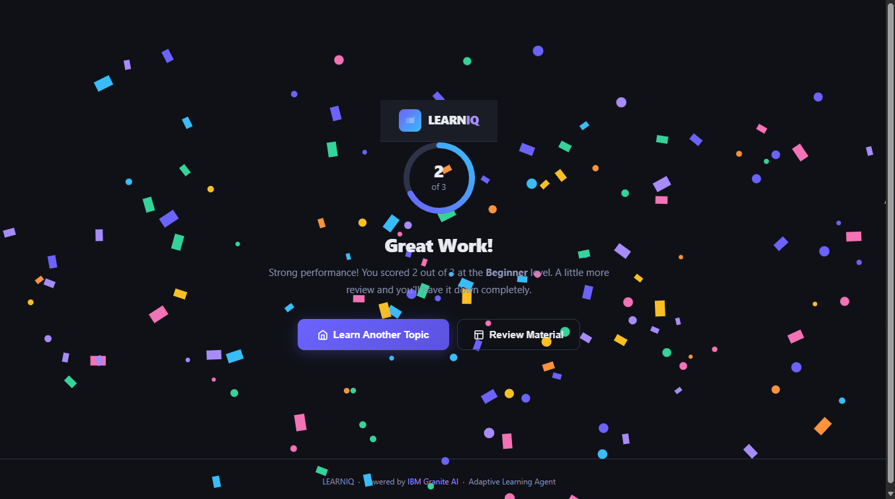
Project Output Screenshot
Please put IBM Bob output screenshots with 2-3 prompts.
You can take 2-3 more slides for each screenshot
·
·
·

Slide 23
Project Output Screenshot
Prompt:
Build a complete working LEARNIQ – Course Content Simplification Agent with a professional frontend and functional backend.
Backend: Use IBM Granite to analyze academic content and adapt it to the selected proficiency level: Beginner, Intermediate, Advanced, or Expert. Preserve the original meaning and return structured results.
Frontend: Create a clean, modern student-friendly interface with:
Course/content text input
Proficiency level selector
Simplify button
Structured result cards
Show these results:
Adapted Explanation
Key Concepts
Important Terms
Real-World Analogy
Example
Common Misconception
3-question Quick Quiz with answers
Connect the frontend to the backend so the complete flow works end-to-end.
·
·
·

Slide 24
Novelty and Uniqueness
LEARNIQ stands out by combining Agentic AI, adaptive learning, and interactive assessment into one personalized learning system.
Adaptive Learning Levels – Explains the same academic topic at Beginner, Intermediate, Advanced, or Expert levels.
Meaning Preservation – Changes the complexity of the explanation while keeping the original concept and important information.
Structured Learning – Combines explanations with key concepts, terms, examples, analogies, and misconceptions in one response.
Interactive Learning – Uses flip flashcards to make important terms easier to learn and remember.
Instant Assessment – Includes a 3-question quiz with instant feedback and score evaluation.
Level Switching – Students can try the same topic at different levels based on their understanding.
Complete Learning Flow – Combines Learn → Explore → Practice → Evaluate instead of only generating an explanation.
This makes LEARNIQ a personalized and interactive AI learning assistant, rather than just a content simplification tool.

Slide 25
Git Hub Link
https://github.com/deepikae1504/content_simplify_agent.git
·
·
·

Slide 26
Future Scope
More Learning Levels – Add more personalized levels based on students’ knowledge and learning needs.
Multiple Languages – Support regional and international languages for wider accessibility.
PDF & Document Support – Allow students to upload notes, textbooks, and study materials directly.
Personalized Learning Paths – Recommend topics and learning activities based on quiz performance.
Voice-Based Learning – Add speech input and audio explanations for easier learning.
Progress Tracking – Track quiz scores, topics completed, and improvement over time.
Advanced AI Tutoring – Enable interactive follow-up questions and doubt clarification.
·
·
·

Slide 27
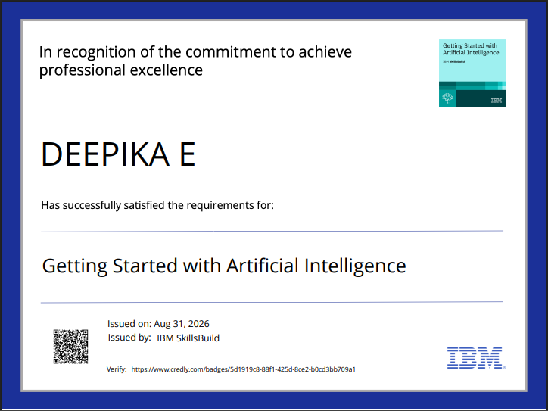
Certificates Earned:
Please add your credly certificate(Getting Started with Artificial Intelligence)

Slide 28
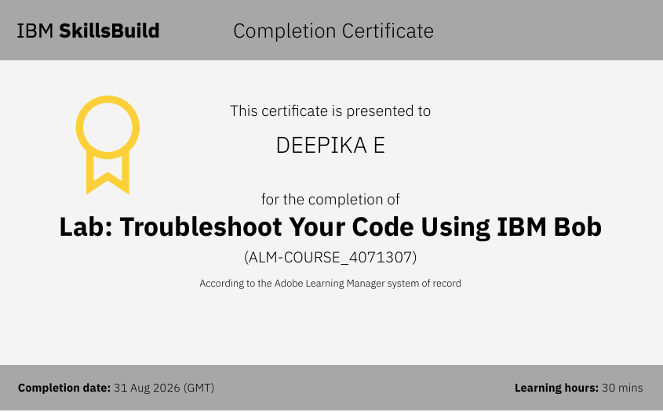
Certificates Earned:​
Add your IBM BOB Certificate

Slide 29


